Slide 1
DSA COURSE PROJECT
Dept. of MCA
TOPIC: Ticket Window
Guide Name :-
Prof. Ranjana Jadhav
Project By:
Group 10
30-Ritika Joshi
32-Deepak Kamble
33-Chetna Khandagale
35-Mayuri Kulkarni
38-Kushagra Mishra

Slide 2
Objectives and Aim
Aim :
The aim of this project is to provide tickets to its customers by using application of queue .
Queuing theory aims to design balanced systems that serve customers quickly and efficiently but do not cost too much to be sustainable.

Slide 3
Objective :
The objective of this project to design and develop a application that works locally and can be managed by a single employee , and having a friendly GUI making it easy for a beginner to interact with the application.
The objective here is to create a fully functional application that allows its users to purchase tickets and according to a real life queue their orders will be processed

Slide 4
The system shall have a menu through their the operating employee can perform operation such as booking tickets , processing ticket requests , checking current queue status and he / she can exit the application .

Slide 5
Feasibility of the project
Feasibility study includes consideration of all possible ways to provide a solution to the given problem. The proposed solution should satisfy all the user requirements and should be flexible enough so that future changes can be easily done based on the future upcoming requirements.

Slide 6
Technical feasibility :
This project is developed by using c++ and using queue operation ( data structures algorithm ) for its fully functioning . The project is developed in Microsoft Windows platform. All the resources needed for the development of the software as well as the maintenance of the same is available with the user.

Slide 7
OUTPUT

Slide 8
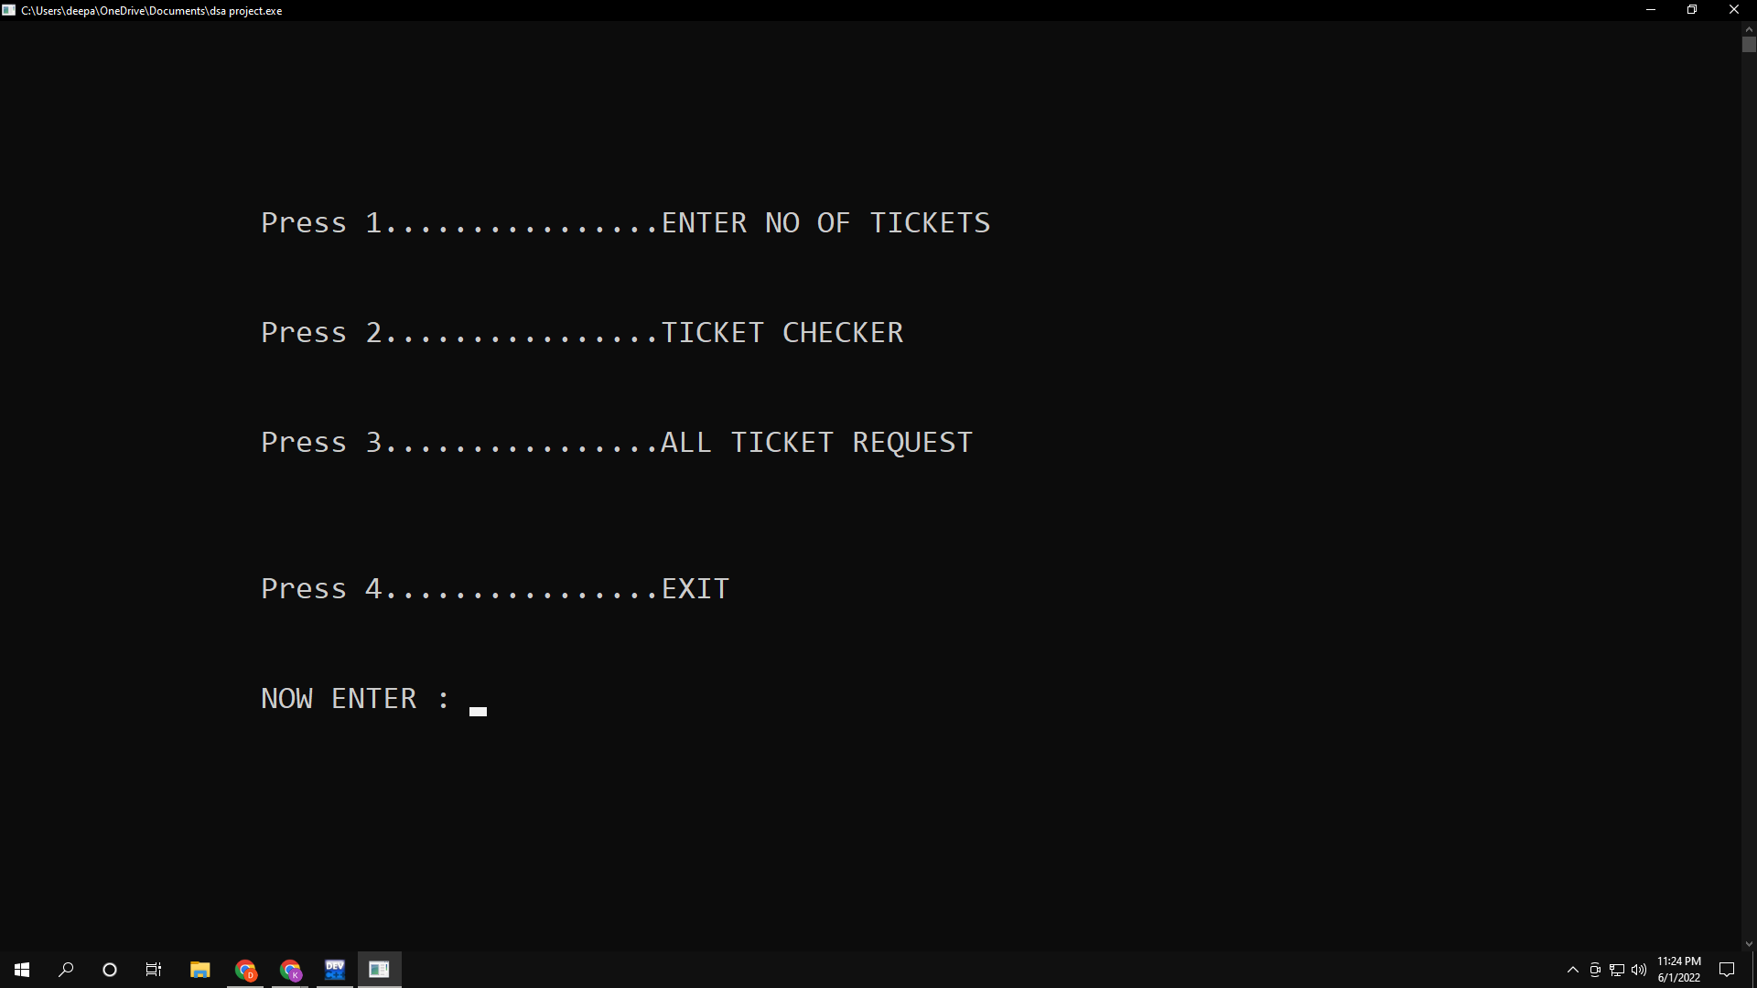

Slide 9
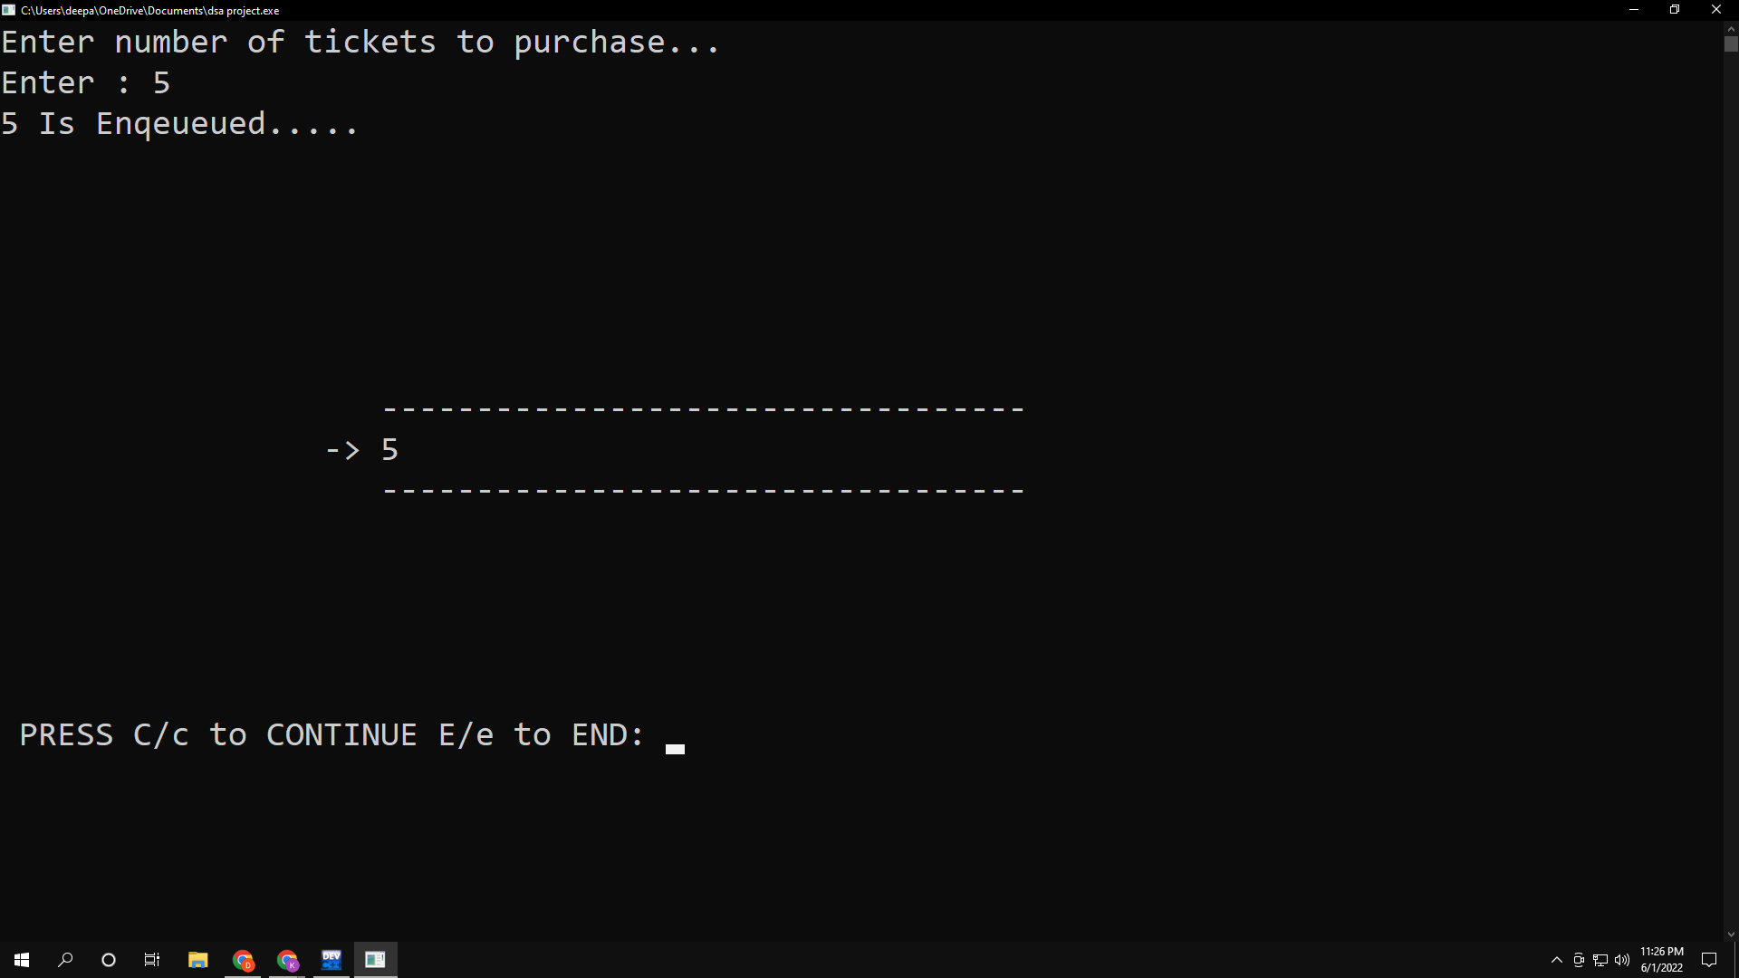

Slide 10
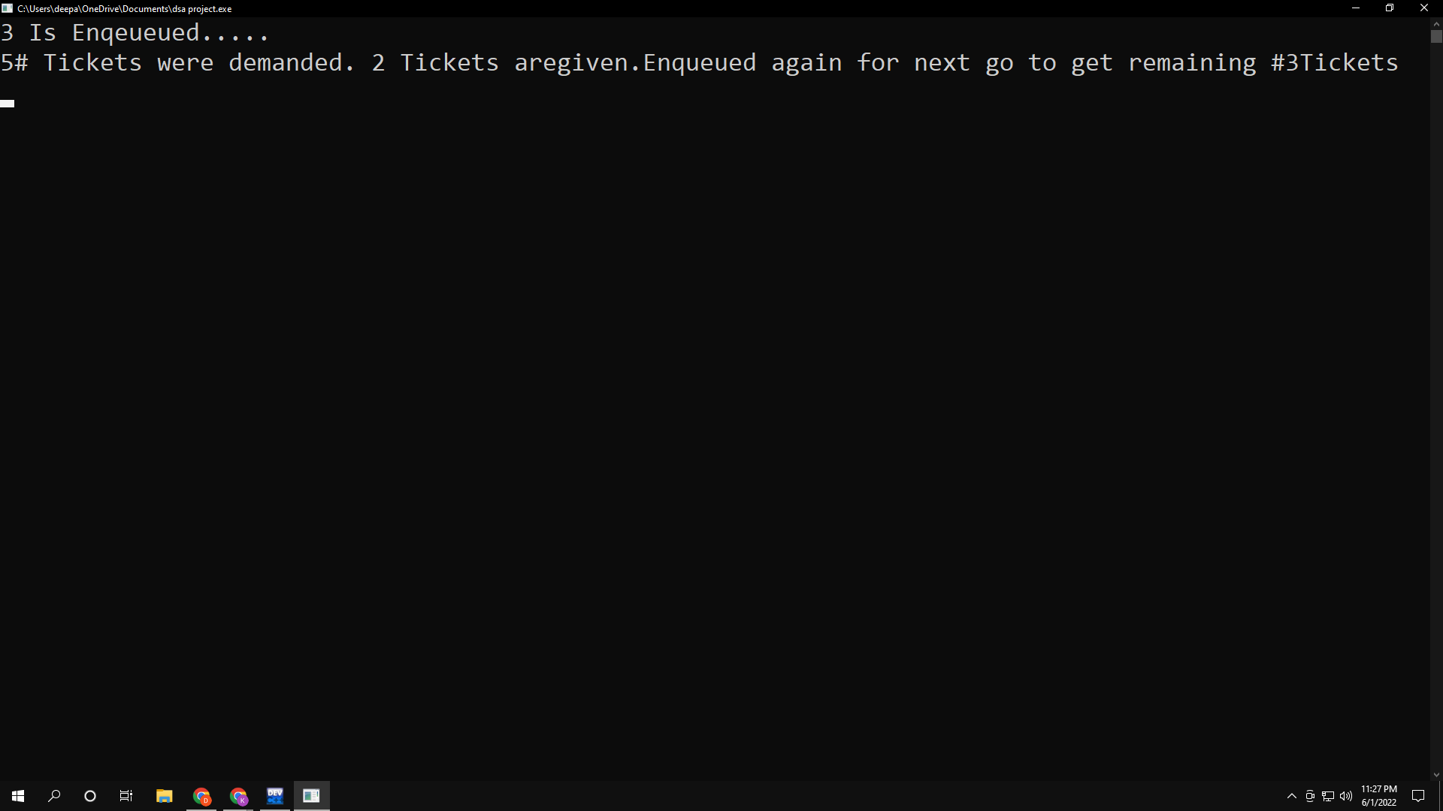

Slide 11
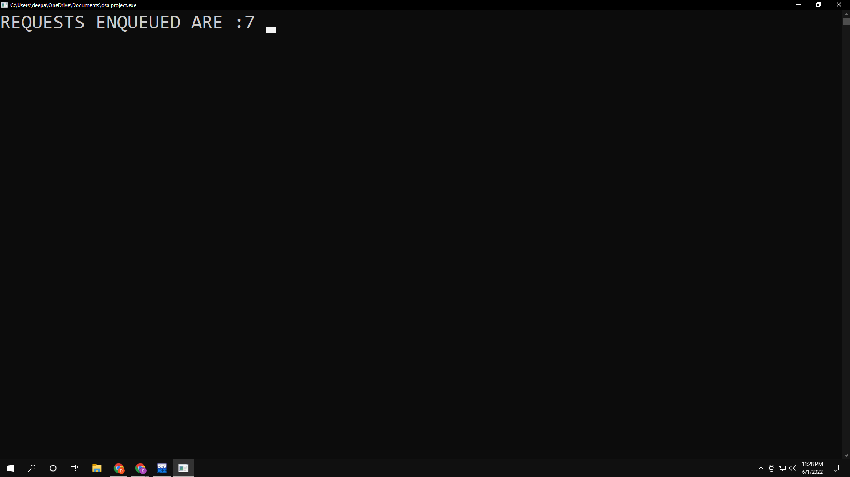

Slide 12
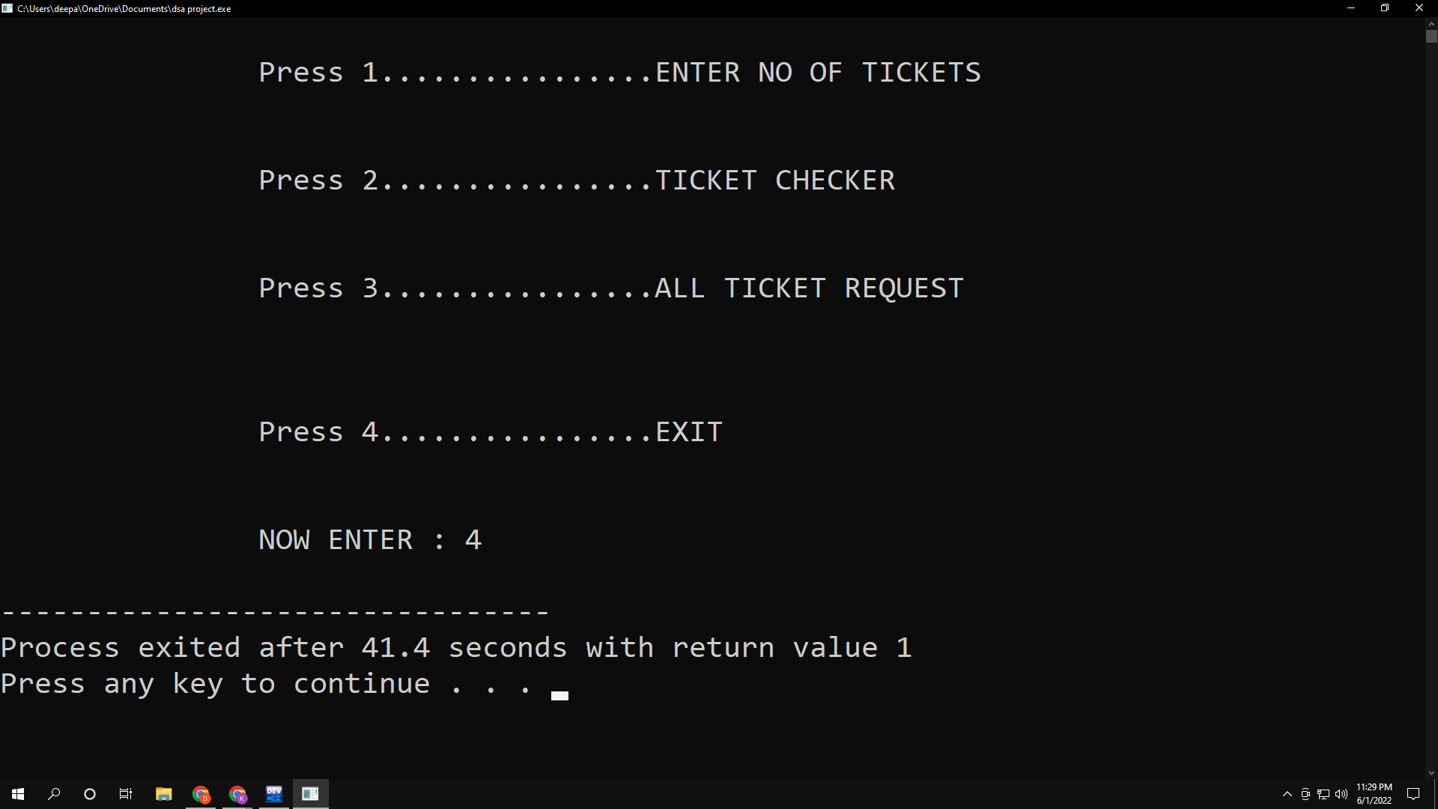

Slide 13
Conclusion
This Project helps distribute to ticket using queue ,and help to understand the working of queue data structure. First the system let the user to choose the different Options. By taking an option into action the system can perform different task such as, Demanding(ENQUEUE) the quantity of tickets by the user and by each turn the system distribute(DEQUEUE) 2 tickets to the user. The queue data structure is a linear type of data structure that is used to store the elements. In this data structure elements are stored in the FIFO technique. A queue data structure used an array or linked list during its implementation. Insertion in queue occurs at the REAR end, and deletion from queue occurs at the FRONT end. This type of data structure is used for serving various requests by a single shared resource.

